Slide 1

4th International Conference on Electrical, Computer and Communication Engineering (ECCE)
Chittagong University of Engineering & Technology, Bangladesh.
Distinguishing Between Formal and Colloquial: A Multilingual BERT Approach to Bengali Language Classification
Authors
Sagor Aich Dept. of CSE, RUET. sagor.aichh@gmail.com | Koshik Debanath Dept. of CSE, RUET. koshik.debanath@gmail.com | Azmain Yakin Srizon Assistant Professor, Dept. of CSE, RUET. azmainsrizon@gmail.com

Slide 2
Outlines
Introduction
Problem Statement
Related work
Dataset description
Methodology
Experimental analysis
Conclusion
Future Work
References

Slide 3
Introduction
Bengali language, rich in history and cultural significance, poses unique challenges in Natural Language Processing (NLP) due to its dual-register structure: Sadhu (formal) and Cholit (colloquial).
‘Sadhu’ (formal) and ‘Cholit’ (colloquial), differing in syntax, vocabulary, and usage
Bengali Language Classification

Slide 4
Problem Statement
Existing NLP models fail to accurately classify Bengali text into Sadhu or Cholit.
Limited datasets available for effective training.
developed a fine-tuned mBERT model that can accurately classify Bengali text

Slide 5
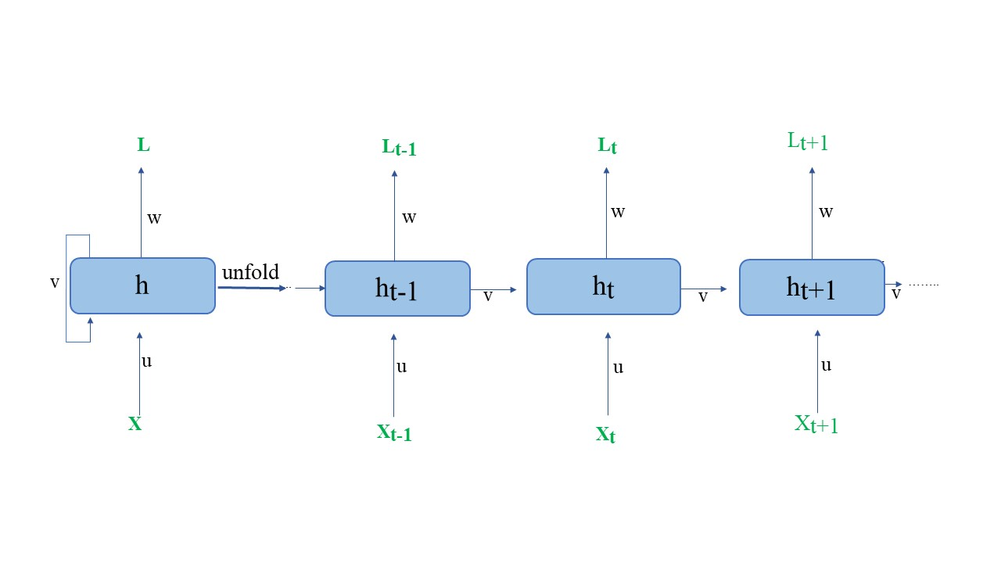
Related work
Learning long-term dependencies with gradient descent is difficult [1]
Generating Sequences With Recurrent Neural Networks [2]
Fig. 1: Architecture of Recurrent Neural Networks for Sequential Data Processing

Slide 6
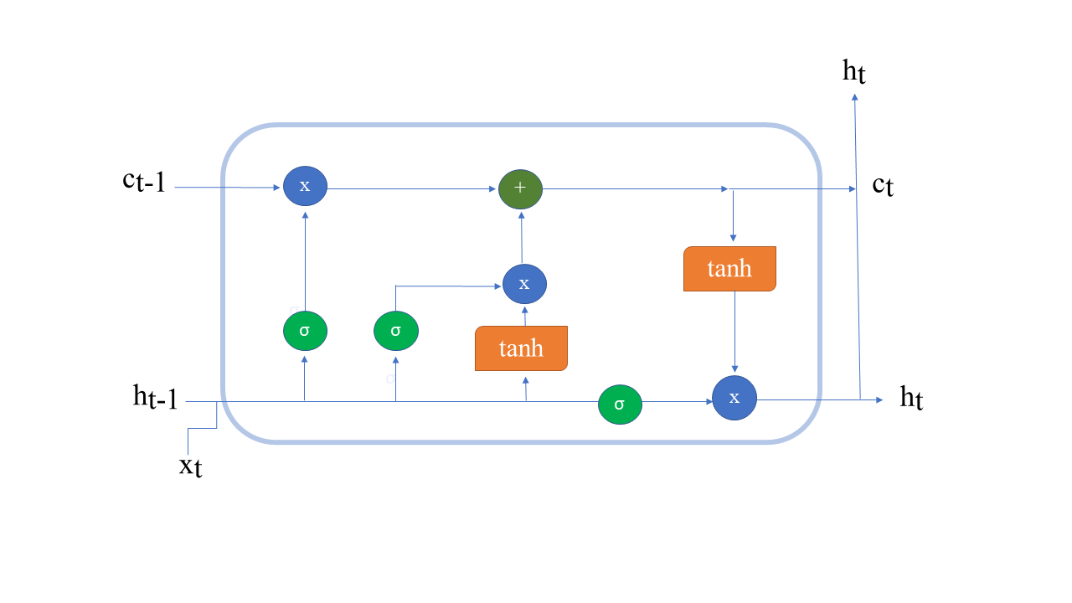
Related work
Works where sentiment analysis [3] and parts-of-speech tagging [4] were done using Long Short-Term Memory
Fig. 2: Long Short-Term Memory (LSTM) Network Architecture for Capturing Long-Range Dependencies

Slide 7
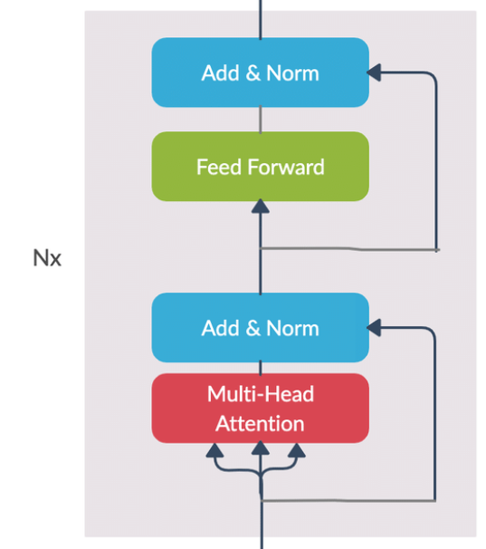
Related work
cross-language text generation, hate speech detection, text classification [5]
Fig. 3 : mBERT Architecture [6]

Slide 8
Dataset Description
A dataset from Mendeley [7]
dataset used in this study, titled ”BanglaBlend: A Large-Scale Novel Dataset of Bangla Sentences Categorized by Saint (Sadhu) and Common (Cholit) Form of Bengali Language”
Table 1 : Class Distribution of Dataset for Sadhu and Cholit Styles
Class | Number of Instances
Total Data | 7350
Sadhu | 3675
Cholit | 3675

Slide 9
Dataset Description
Table 2 : Sample Sentences Demonstrating Sadhu and Cholit Styles in Bengali
Category | Sample Sentences
Sadhu | ‘সেখানকার জানালা দিয়ে সমুদ্র দেখা যাইতেছিল’, ‘আমি কিছু দেখিতে পারিতেছি না’, ‘সকলেরই অনাবৃত দেহ সকলের সেই অনাবৃত বক্ষে আরশির ধুকধুকি চন্দ্রকিরণে এক একবার জ্বলিয়া উঠিতেছে’, ‘মেয়েটি সেদিন ভিক্ষুককে সাহায্য করিয়াছিল’, ‘তুমি প্রশংসা কর না কর বৃদ্ধ বসিয়া তোমায় পুরাতন কথা শুনাইবে’
Cholit | ‘নিজেকে আপনার মূল্যবোধের প্রতি সত্য থাকুন অন্য কারো জন্য আপনি কে আপস করবেন না’, ‘আমি গোসল করে খেতে যাব’, ‘সংবাদপত্রে স্বাধীনতা আন্দোলনের বিভিন্ন সংবাদ ছাপা হতো’, ‘তাকে বলা যায় টারজান জীবনের চেয়েও বড় একজন মহানায়ক’, ‘আমি এই ছুটিতে পরিবারের সাথে ঘুরতে গিয়েছিলাম’

Slide 10
Methodology
Data Loading and Splitting:
an Excel file containing Bengali sentences and their corresponding class labels
Using Pandas library, the data is read and prepared
training and testing ration 0.8 : 0.2

Slide 11
Methodology
Model Initialization:
pretrained multilingual BERT model (‘bert-basemultilingual-cased’)
This model, pre-trained on multiple languages

Slide 12
Methodology
Data Tokenization:
converts sentences into numerical representations that the model can process
Each token is further mapped to an embedding vector.
Sentences longer than the maximum token limit ‘Lmax’ are truncated
shorter sentences are padded
ensures that all inputs have a consistent dimension

Slide 13
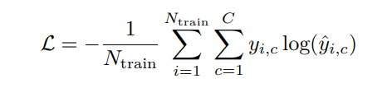
Methodology
Training Configuration:
configured with specific hyperparameters.
cross-entropy loss
Epoch = 3
Per device train batch size = 8
per device eval batch size = 16
warmup steps = 500
weight decay = 0.01
logging steps = 10

Slide 14

Methodology
Model Training:
Hugging Face Transformers library’s Trainer class
‘AdamW’ optimizer
update rule for a model parameter ‘θ’ at step ‘t’ is

Slide 15
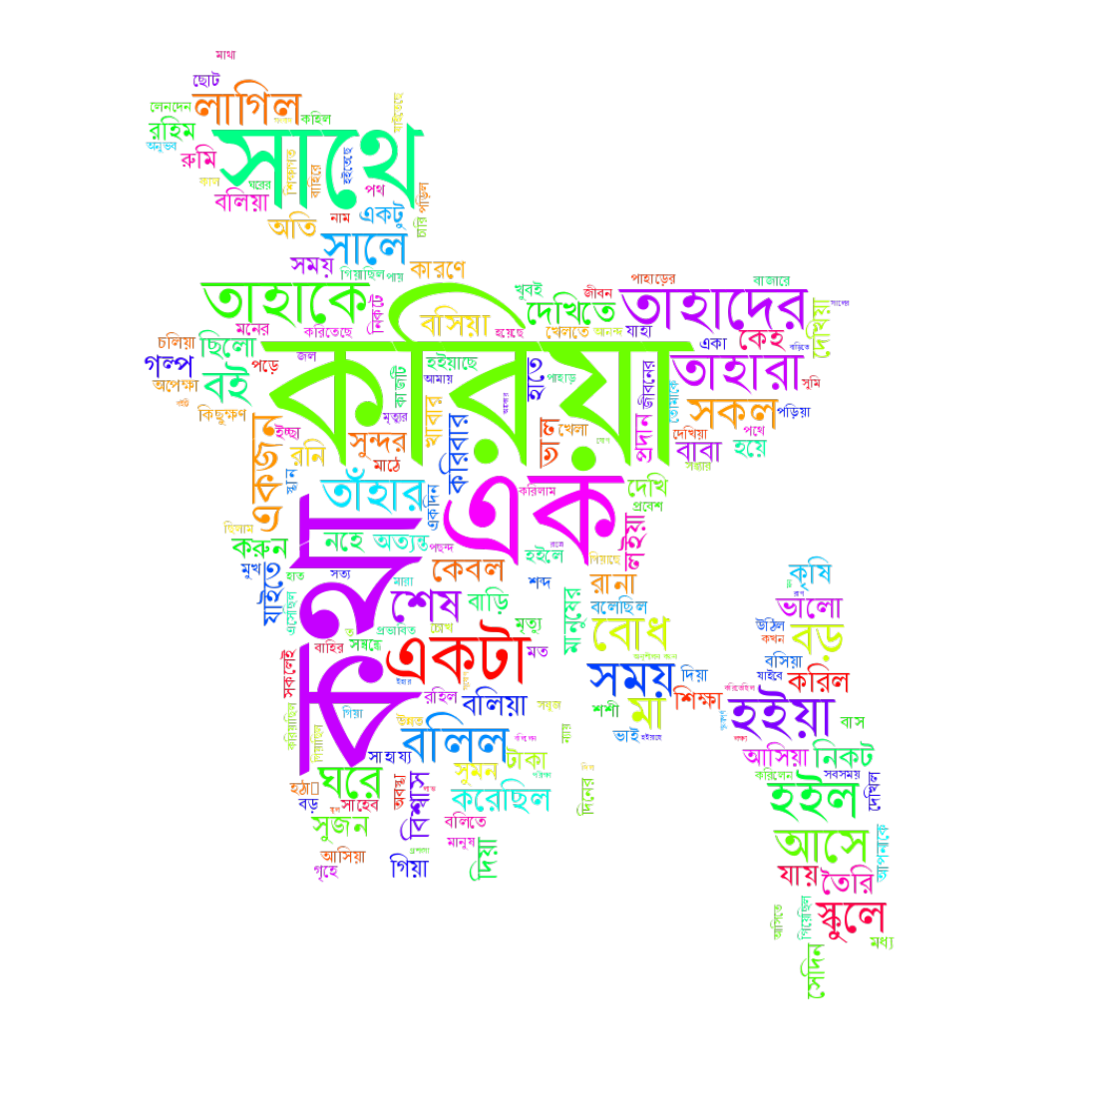
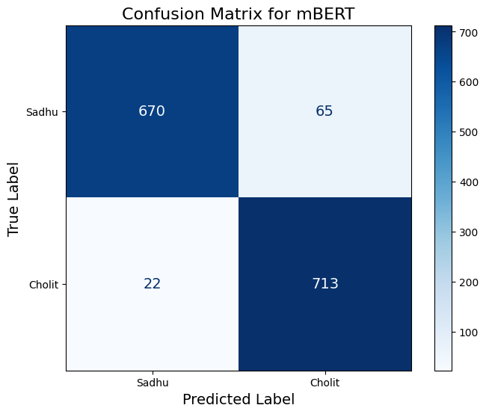
Experimental analysis
Fig. 4: Confusion Matrix Depicting Classification Results for mBERT Model
Fig. 5: Visualization of Frequent Words in Dataset Sentences Using a Word Cloud

Slide 16
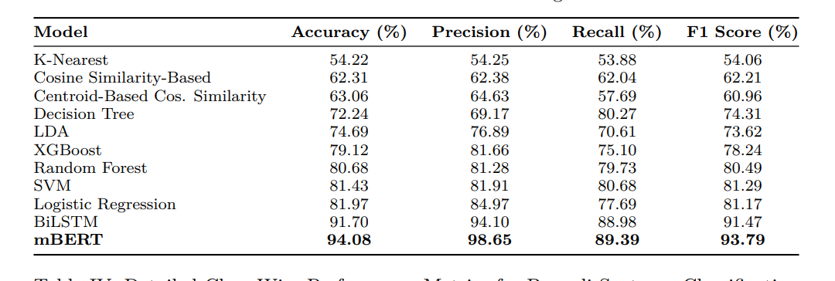
Experimental analysis
Table 3 : Performance Metrics of Various Models for Bengali Sentence Classification

Slide 17
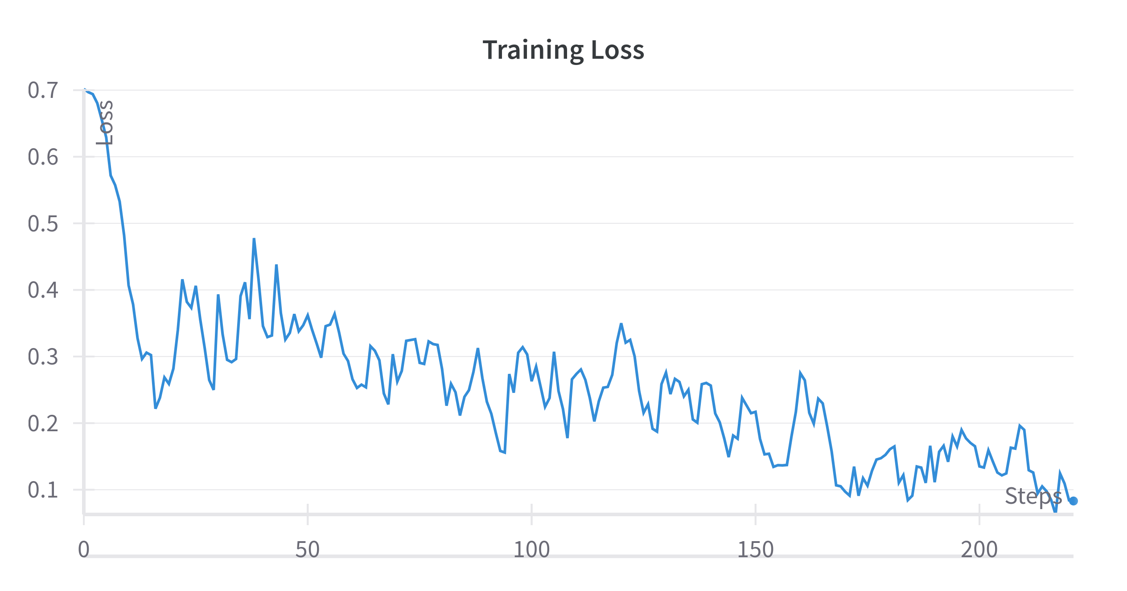
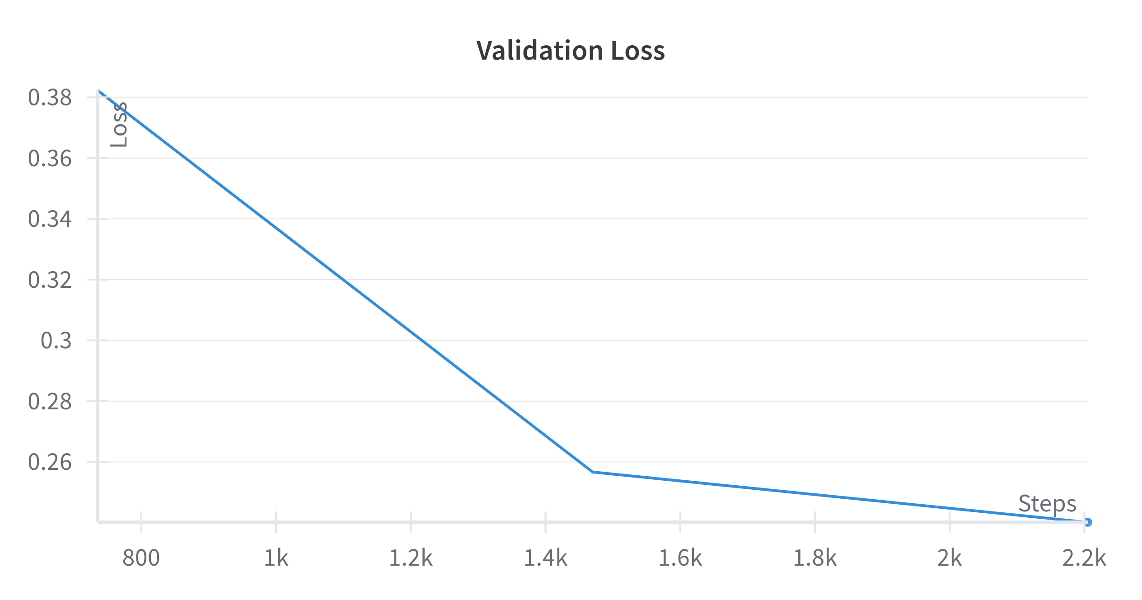
Experimental analysis
Fig. 6 : Training Loss Progression Across Epochs
Fig. 7 : Validation Loss Progression Across Training Epochs

Slide 18
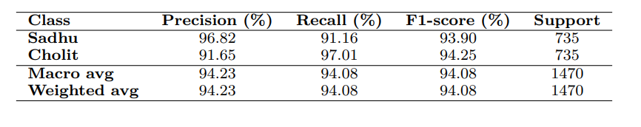
Experimental analysis
Table 4 : Detailed Class-Wise Performance Metrics for Bengali Sentence Classification

Slide 19
Conclusion
Experimental evaluation achieved 94.08%
Avoid significant overfitting
Contribute significantly to the field of Bengali Natural Language Processing (NLP)
Demonstrate the feasibility and potential of using transformer-based models

Slide 20
Future Work
Using very large scale dataset
0ptimization could be achieved by exploring alternative architectures or fine-tuning methods.
Using other South Asian languages

Slide 21
References
[1] Y. Bengio et al., “Learning long-term dependencies with gradient descent is difficult,” IEEE Transactions on Neural Networks, vol. 5, no. 2, pp. 157–166, 1994.
[2] A. Graves, “Generating sequences with recurrent neural networks,” arXiv preprint arXiv:1308.0850, 2013.
[3] A. Ahmed and M. Yousuf, Sentiment Analysis on Bangla Text Using Long Short-Term Memory (LSTM) Recurrent Neural Network, 01 2021, pp. 181–192.
[4] S. Sarkar and B. Anupam, “Part-of-speech tagging for bengali,” 01 2007.
[5] A. Velankar, H. Patil, and R. Joshi, “Mono vs multilingual bert for hate speech detection and text classification: A case study in marathi,” in Artificial Neural Networks in Pattern Recognition.
[6] Available at : https://www.researchgate.net/figure/BERT-model-architecture_fig4_348740926
[7] Available at : https://data.mendeley.com/datasets/7rx9mk8v4m/3

Slide 22
Thank You

